Slide 1
Daily Review
CFU 1
What is the name given to the shape of a DNA strand?
DNA stands for Deoxyribonucleic Acid.
DNA is made of molecules called nucleotides, which form a double helix structure.
Nucleotides are made up of;
A phosphate group
A deoxyribose sugar
A nitrogenous base
Chargaff’s rule states that each nitrogenous base will only bond with one other – complementary base pairs
Adenine (A) and Thymine (T) Base pair
Cytosine (C ) and Guanine (G) Base Pair
CFU 2
Who discovered complementary base pairs?
CFU 3
Name the three main parts of a nucleotide.

Slide 2
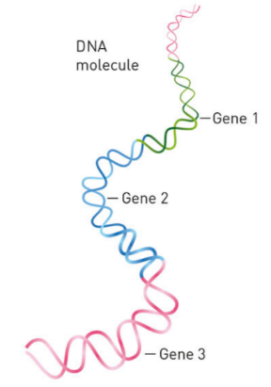
Daily Review
To the right is a DNA strand, in your own words:
Describe the shape of the DNA strand
Explain the structure of a nucleotide (including Chargaff’s rule)

Slide 3
DNA, Genes and Chromosomes

Slide 4
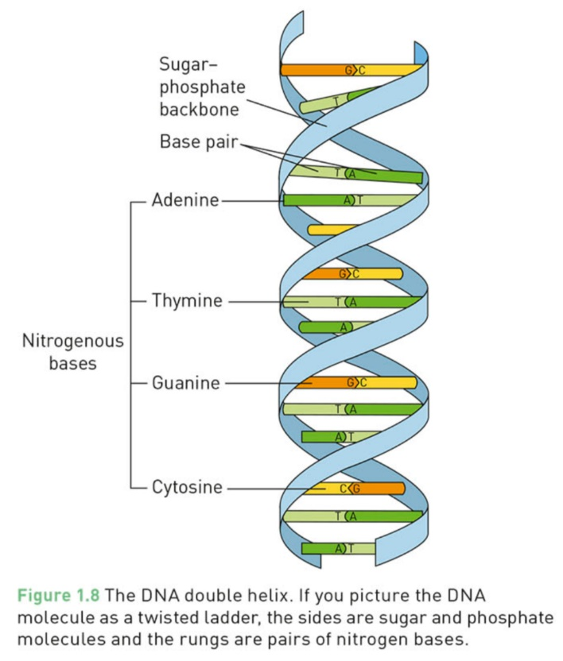
Learning Objectives
CFU
What are we going to learn?
Identify the typical number of chromosomes within a human cell
Describe how DNA is packaged within a cell
Explain the relationship between DNA and genes
Activate Prior Knowledge
Do you think that all humans have the same sequence of bases in their DNA? If yes, why? If no, why?
What effect may having a different sequence of bases have on your characteristics?

Slide 5
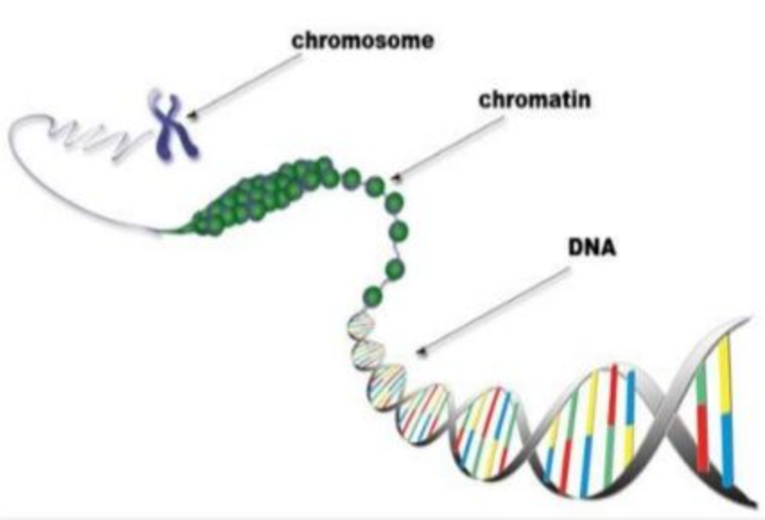
Concept Development
CFU 1
When does DNA become visible in the cell?
Forms of DNA
Within the nucleus of a cell, the DNA is loosely packaged similar to wool, so that it can be easily accessed
This form of DNA is called chromatin
When a cell prepares to reproduce, the DNA condenses into a tight package known as a chromosome
At this point the chromosomes are visible within the nucleus
Most cells within the human body contain 46 chromosomes
23 come from the father, 23 from the mother
CFU 2
A dog has 78 chromosomes, a butterflies 190 chromosomes, how many do humans have?
CFU 3
Think-pair-share: Why do you only get half the number of chromosomes from each parent?

Slide 6
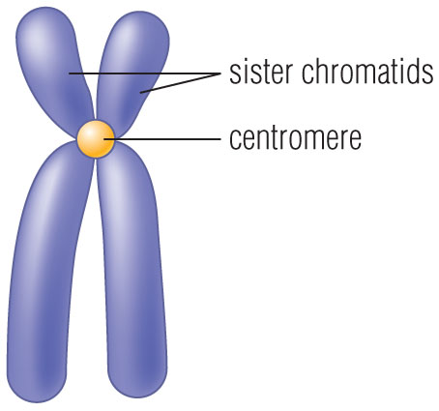
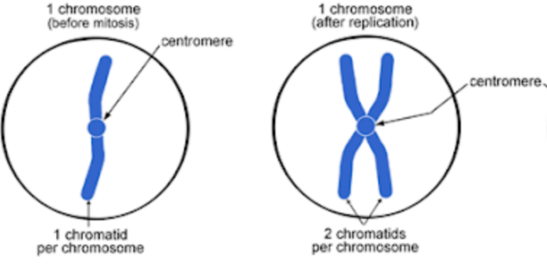
Concept Development
CFU 1
A chromosome can contain either one or two copies of DNA. What is the name given to each?
Chromosomes
Cell may contain one or two copies of the genetic material depending where they are in their life cycle
One copy = single stranded chromosome
Two copies = double stranded chromosome
Each individual copy of the genetic material (within a chromosome) is called a chromatid
Single stranded chromosome has one chromatid
Double stranded chromosome has two chromatids
Two chromatids join in the middle at a point called the centromere and can be referred to as sister chromatids
CFU 2
State the name given to each copy of DNA within a chromosome.
CFU 3
Where can the centromere be found in a double stranded chromosome?

Slide 7
Concept Development
CFU 1
What is a centromere?
Putting it all together
Unravelled DNA in the nucleus is called chromatin.
When it condenses and becomes visible it is called a chromosome
A chromosome can have one or two copies of the DNA
Single stranded or double stranded
Individual copies of the DNA are called chromatids
The chromatids join at a point in the middle known as the centromere.
https://www.youtube.com/watch?v=4Jp9OxYxMVc
CFU 2
How many chromatids in a chromosome? Explain your answer.
CFU 3
Think-pair-share: why do you think that the DNA looks different just before a cell reproduces?

Slide 8
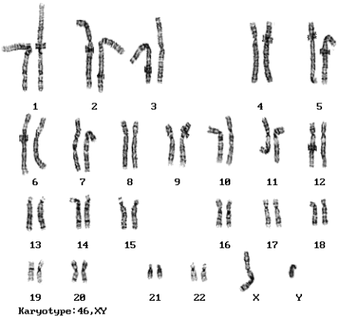
Concept Development
CFU 1
What is a Karyotype?
Karyotype and Homologous Pairs
All 46 chromosomes in a human are organised into pairs, known as homologous pairs
One of each pair is inherited from each parents (23 from your father and 23 from your mother)
A pictorial representation of all of the chromosomes in a cell (shown in homologous pairs) is called a karyotype
The first 22 pairs (44 total) chromosomes are called autosomes and determine the general characteristics and function of an organism
The last two chromosome are called sex chromosomes and determine the gender of the individual
X X = female
X Y = male
CFU 2
What are autosomes and sex chromosomes?
CFU 3
What sex chromosomes for a male and for a female?

Slide 9
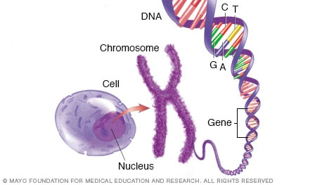
Concept Development
CFU 1
Which are larger DNA or genes?
Genes
DNA in chromosomes consists of small sections that are called genes, which determine characteristics of an organism
The different orders in which the nitrogenous bases are arranged within a gene, are what gives the individual their unique characteristics
E.g. hair colour, eye colour, skin colour
Genes are passed down from parents to offspring
This is why family members often share similar traits
CFU 2
Explain the relationship between DNA and genes
CFU 3
What does the order of nitrogenous bases within a gene determine?

Slide 10

Skill Development/Guided Practice
Which form of DNA is it?
Gene – small section of DNA Chromatin – unwound form of DNA Single stranded chromosome – condensed DNA with one chromatid Double stranded chromosome – condensed DNA with sister chromatids
Describe the form the DNA is shown as in the picture below, justify your answer.
This is a single stranded chromosome. It is made of condensed DNA with one chromatid.

Slide 11
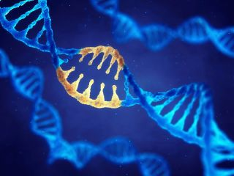
Skill Development/Guided Practice
Name the DNA structure
Gene – small section of DNA Chromatin – unwound form of DNA Single stranded chromosome – condensed DNA with one chromatid Double stranded chromosome – condensed DNA with sister chromatids
Describe the form the DNA is shown as in the picture below, justify your answer.
The image shows a gene. A gene is a small section of DNA.

Slide 12
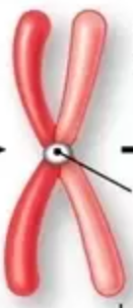
Skill Development/Guided Practice
Name the DNA structure
Gene – small section of DNA Chromatin – unwound form of DNA Single stranded chromosome – condensed DNA with one chromatid Double stranded chromosome – condensed DNA with sister chromatids
Describe the form the DNA is shown as in the picture below, justify your answer.
The image shows a double stranded chromosome. A double stranded chromosome is made of condensed DNA and sister chromatids.

Slide 13
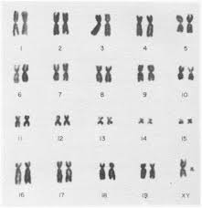
Skill Development/Guided Practice
Is the DNA human
46 chromosomes (23 pairs) – Human NOT 46 chromosomes (23 pairs) – NOT human
Examine the karyotype below and determine whether or not it is the DNA of a human.
This is not human DNA as the karyotype shows less than 46 (23 pairs) of DNA.
(It’s a Canadian Beaver)

Slide 14
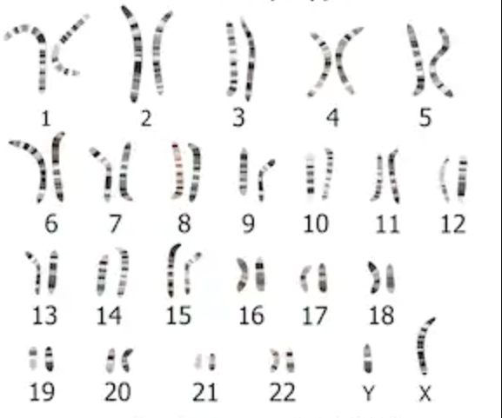
Skill Development/Guided Practice
Is the DNA human
46 chromosomes (23 pairs) – Human NOT 46 chromosomes (23 pairs) – NOT human
Examine the karyotype below and determine whether or not it is the DNA of a human.
This is human DNA as the karyotype shows 46 (23 pairs) of DNA.

Slide 15
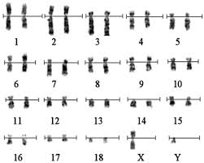
Skill Development/Guided Practice
Is the DNA human
46 chromosomes (23 pairs) – Human NOT 46 chromosomes (23 pairs) – NOT human
Examine the karyotype below and determine whether or not it is the DNA of a human.
This is not human DNA as the karyotype shows less than 46 (23 pairs) of DNA.
(It’s a Siberian Tiger)

Slide 16
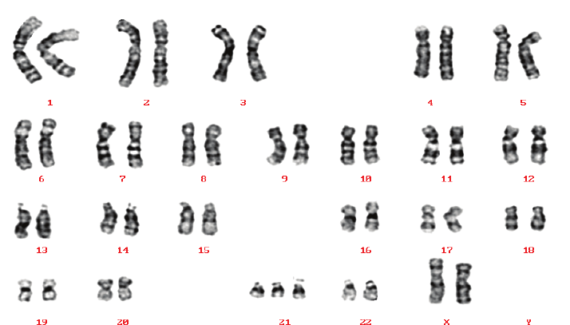
Skill Development/Guided Practice
Is the DNA human
46 chromosomes (23 pairs) – Human NOT 46 chromosomes (23 pairs) – NOT human
Examine the karyotype below and determine whether or not it is the DNA of a human.
Trick question!
This is human DNA, it has 23 pairs of chromosomes, however it has an extra copy of the 21st pair of chromosomes.
This is a genetic abnormality leading to Down Syndrome.

Slide 17
Relevance
Understanding the way that DNA is organised within your cells will help you as you learn how cells divide.
Understanding genes, and the effect that they have on your traits will help you to understand how you inherit characteristics.
Uses for karyotypes
Used to diagnose genetic illnesses
Used in forensics to differentiate human from animal DNA
Help identify a species based on the numbers of chromosomes

Slide 18
Skill Closure
Draw and label a double stranded chromosome.
Skill Closure
Fill in the blanks:
1. Chromosomes are found in the ____ of a cell.
2. The unravelled string like form of DNA is called _____.
3. Sections of the DNA form _____ which are the chemical instructions guiding the cell’s activity.
4. Each chromosome is made of two strands called _______ that are held together by a __________.
Skill Closure
Describe the two different types of chromosomes found on a karyotype.

Slide 19
Independent Practice
Match the numbers with their corresponding letters below
Human A Different order of nitrogenous bases in a gene
Centromere B X Y
Male C Individual copy of the genetic material
Female D Middle point, joins copies of genetic material
Chromatids E 46 Chromosomes
Genes F X X
Hair colour G Part of a chromosome determining characteristics
Forensic scientists are relying increasingly on evidence that comes from DNA fingerprinting. Find out how this is done and why it is so useful in providing evidence of a crime. Present arguments for and against the collection of a DNA database from the community at large.
Complete the worksheet on connect.

Slide 20
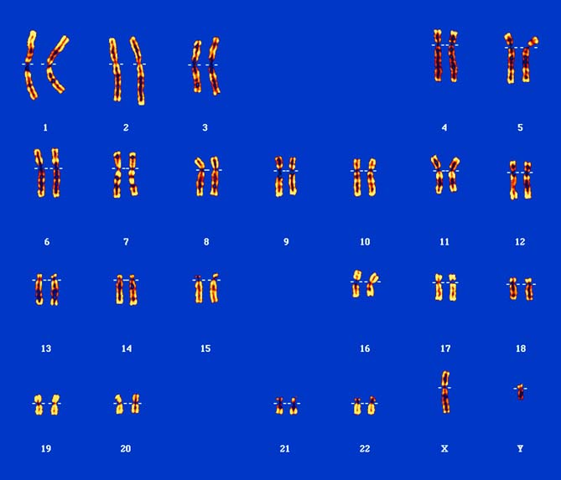
Answers to Worksheet
Arrange the following structures from smallest to largest;
Gene Chromosome Nucleotide Phosphate
1. Arrange the following structures from smallest to largest;
Gene Chromosome Nucleotide Phosphate
Phosphate, Nucleotide, Gene, Chromosome
3. Is the karyotype above for a male or a female? How can you tell? MALE
For a male, as it shows one X chromosome and one Y chromosome. If it were for a female, there would be two X chromosomes.
4. If unravelled, the DNA of a single cell would be approximately 2 metres long. Explain how it fits inside a cell.
DNA is tightly coiled around histone proteins, which are also coiled together, condensing the DNA into chromosomes that fit within a single cell.
5 A gene is a section of DNA. Explain what makes one gene different from any other gene within a DNA strand.
The nitrogen base sequence within the particular section of DNA for a gene makes it different from any other gene.

